Slide 1
UNIT-III
Transmission media & switching
Notes:
Br

Slide 2
b) Switching
Circuit-Switched Networks
Datagram Networks
Virtual-Circuit Networks
Structure of a Switch

Slide 3
Introduction
A network is a set of connected devices.
Whenever we have multiple devices, we have the problem of how to connect them to make one-to-one communication possible.
Possible solutions are
- make a point-to-point connection between each pair of devices ( a mesh topology)
- make a point-to-point connection between a central device and every other device (a star topology)
- multipoint connections, a bus
All the above are more or less impractical and wasteful when applied to very large networks.
A better solution is switching.

Slide 4

Switching
A switched network consists of a series of interlinked nodes, called switches.
Switches are devices capable of creating temporary connections between two or more devices linked to the switch.
In a switched network, some of these nodes are connected to the end systems, others are used only for routing.
Switched Network

Slide 5

Taxonomy of Switched Networks
In message switching, each switch stores the whole message and forwards it to the next switch. It is phased out in general communications but still has networking applications.

Slide 6

Circuit-switched Networks(1)
A circuit-switched network consists of a set of switches connected by physical links.
A connection between two stations is a dedicated path made of one or more links.
Each connection uses only one dedicated channel on each link.
Each link is normally divided into n channels by using FDM or TDM.
A circuit-switched network

Slide 7
Circuit-switched Networks(2)
Three phases
Actual communication requires three phases:
- connection setup
- data transfer
- connection teardown
Setup phase
Before the parties can communicate, a channel (circuit) is reserved on each link.
Combination of channels defines the dedicated path.
Data transfer phase
After the establishment of dedicated circuit (channels), the two parties can transfer data.
Teardown phase
When one of the parties needs to disconnect, a signal is sent to each switch to release the resources.

Slide 8

Circuit-Switched Network: Example 1
A circuit-switched network to connect 8 telephones in a small area.

Slide 9

Circuit-Switched Network: Example 2
A circuit-switched network that connects computers in two remote offices of a private company.

Slide 10

Circuit-switched Networks(5)
Not as efficient as other two types of networks as resources allocated for a connection are not available for other connections during the entire duration of the connection.
Delay is minimal.
Switching at the physical layer
in the traditional telephone
network uses the circuit-
switching approach.
Delay in circuit-switched network

Slide 11
Packet-Switched Networks
If a message is going to pass through a packet-switched network, it needs to be divided into packets of fixed or variable size.
Size of the packet is determined by the network and governing protocol.
In packet switching, there is no resource allocation for a packet, means that there is no reserved bandwidth on the links, and there is no scheduled processing time for each packet.
Resources are allocated on demand.
Allocation is done on a first-come, first served basis.

Slide 12
Datagram Networks(1)
In a datagram network, each packet is treated independently of all others.
Packets in this approach are referred to as datagrams.
Switches in a datagram network are referred to as routers.
Datagrams may arrive at their destination out of order.
Datagrams may also be lost or dropped because of a lack of resources.
Sometimes referred to as connectionless networks.
Switching in the Internet is done by using datagram approach at the network layer.

Slide 13


Datagram Networks(2)
Routing Table
A switch in a datagram networks uses a routing table that is based on the destination address.
Routing tables are dynamic and are updated periodically.
Every datagram carries a header.
The destination address in the header of a datagram remains the same during the entire journey of the packet.

Slide 14

Datagram Networks(3)
Efficiency of a datagram network is better than of a circuit-switched network.
Datagram network may have greater delay than a virtual-circuit network.
Although there are no setup and teardown phases, each datagram may experience a wait at a switch before it is forwarded.
Delay is not uniform.
Delay in datagram network

Slide 15
Virtual-Circuit Networks(1)
A virtual-circuit network (VCN) is a cross between a circuit-switched network and a datagram network.
It has some characteristics of both:
- there are setup, data transfer, and teardown phases as in a circuit-switched network
(CSN)
- resources can be allocated during setup phase, as in a CSN, or on demand as in a
datagram network (DN)
- As in DN, data are packetized and each packet carries an address in the header. This
address is local i.e., it is the address of the next switch not the end system
- As in CSN, all packets follow the same path established during the connection
- VCN is normally implemented in the data link layer, while CSN is in physical layer and
DN in the network layer

Slide 16

Virtual-Circuit Networks(2)
Addressing
Two types of addressing: global and local (virtual-circuit identifier: VCI)
Global address is used only to create a VCI.
Virtual Circuit Identifier
- the identifier that is actually used for data transfer is called the VCI.
- unlike global address, it is a small number that has only switch scope, used by a
frame between two switches.

Slide 17
Virtual-Circuit Networks(3)
Three Phases
Data transfer phase, setup phase, teardown phase
Data Transfer Phase
To transfer a frame from S to its D, all switches need to have a table entry for this virtual-circuit.
Setup Phase
Switch creates an entry for a virtual-circuit.
Two steps are required: the setup request and the acknowledgement.
Teardown Phase
Two frames are exchanged: the teardown request and teardown confirmation.

Slide 18


Data transfer Phase
Source-to-destination data transfer in a virtual-circuit network

Slide 19

Setup Phase: Setup Request

Slide 20

Setup Phase: Acknowledgement

Slide 21

Virtual-Circuit Networks(8)
In virtual-circuit switching, all packets belonging to the same source and destination travel the same path; but the packets may arrive at the destination with different delays if resource allocation is on demand.
Switching at the data link layer in a switched WAN is normally implemented by using virtual-circuit techniques.

Slide 22
Structure of Circuit Switch
Circuit switching uses either of the two technologies: space-division switch or time-division switch.
Space-division Switch
- in this switching, the paths in the circuit are separated from one another
spatially.
- originally designed for use in
analog networks but is used
currently in both analog and
digital networks.
- crossbar switch, multistage switch

Slide 23

Crossbar Switch
A crossbar switch connects n inputs to m outputs in a grid, using electronic micro switches at each cross point.
Requires n*m cross points
Crossbar Switch

Slide 24
Crossbar Switch: Problem
The number of cross points required is huge.
  Ex : 1000 input, 1000 output → 1,000,000 cross points, which is impractical
Inefficient
  As per statistics, fewer than 25% of the crosspoints are in use at a given time.

Slide 25

Multistage Switch
Solution to the limitation of the crossbar switch.
Combines crossbar switches in several stages (normally 3).

Slide 26
Design of a Three-Stage Switch
Three steps
  Divide the N input lines into groups, each of n lines. For each group, use one crossbar of size n x k, where k is the number of crossbars in the middle stage
  Use k crossbars, each of size (N/n) x (N/n) in the middle stage
  Use N/n crossbars, each of size k x n at the third stage.
N/n(n x k) + k(N/n x N/n) + N/n(k x n) = 2kN + k(N/n)²
= Total no. of cross points
In a three-stage switch, the total number of cross points is much smaller than the number of cross points in a single-stage switch (N²).

Slide 27
Multistage Switch: Example 1
Design a three-stage, 200 × 200 switch (N = 200) with k = 4 and n = 20
In the first stage we have N/n or 10 crossbars, each of size 20 × 4. In the second stage, we have 4 crossbars, each of size 10 × 10. In the third stage, we have 10 crossbars, each of size 4 × 20. The total number of crosspoints is 2kN + k(N/n)², or 2000 crosspoints. This is 5 percent of the number of crosspoints in a single-stage switch (200 × 200 = 40,000).

Slide 28
Multistage Switches
Advantage: The number of crosspoints.
Disadvantage: blocking
(Blocking refers to times when one input cannot be connected to an output because there is no path available between them – all the possible intermediate switches are occupied.)
Small no. of crossbars at the middle stage creates blocking.
Clos criterion: condition of nonblocking
  n = (N/2)^{1/2}
  k > 2n – 1
  Crosspoints ≥ 4N [(2N)^{1/2} – 1]

Slide 29
Multistage Switch: Example 2
Redesign the previous three-stage, 200 × 200 switch, using the Clos criteria with a minimum number of cross points.
We let n = (200/2)^{1/2}, or n = 10. We calculate k > 2n − 1 = 20. In the first stage, we have 200/10, or 20, crossbars, each with 10 × 20 cross points. In the second stage, we have 20 crossbars, each with 20 × 20 cross points. In the third stage, we have 20 crossbars each with 20 × 10 cross points. The total number of cross points is 20(10 × 20) + 20(20 × 20) + 20(20 ×10) = 16000.

Slide 30
Time-division switch
Time Division Switching uses TDM inside a switch.
Time-slot interchange (TSI) – most popular technology.
Fig. shows a system connecting four input lines to four output lines.
Figure combines a TDM multiplexer, a TDM demultiplexer, and a TSI consisting of RAM with control unit.
The size of each location is same as the size of a single time slot.
The no. of locations is the same as the no. of inputs.
The RAM fills up with incoming data from time slots in the order received. Slots are then sent out in an order based on the decisions of a control unit.

Slide 31

Time-Slot Interchange

Slide 32
Time- and Space-Division Switch Combinations
Advantage of space division switching is that it is instantaneous, but requires more no. of cross points.
Advantage of time division switching is that it needs no cross points, but introduces delay.
To take advantage of best of both, combine space-division and time-division technologies.
Fig. shows a simple time-space-time (TST) switch that consists of two time stages and one space stage.
Last stage is a mirror image of the first stage.
Middle stage is a space-division switch (crossbar) that connects the TSI groups to allow connectivity between all possible input and output pairs.

Slide 33
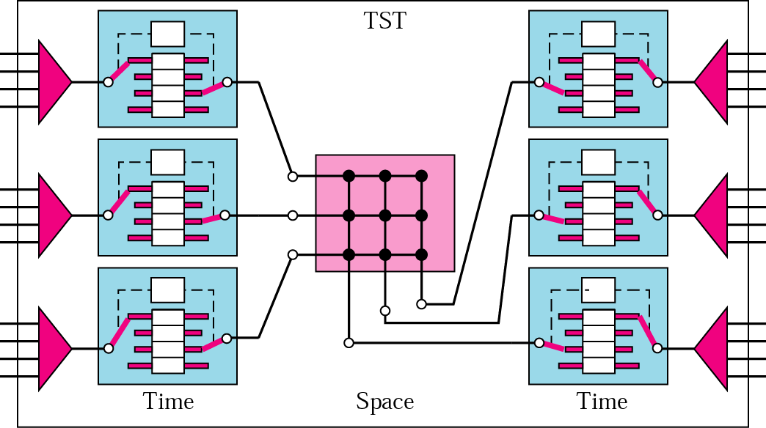
TST Switch

Slide 34

Structure of Packet Switch
Four components: input port, output port, routing processor, and switching fabric.

Slide 35

Structure of Packet Switch(2)
INPUT PORTS
Perform physical and data link functions.
Bits are constructed from the received signal.
Packet is decapsulated from the frame.
Errors are detected and corrected.
In addition to physical layer processor and a data link processor, the input port has buffers (queues) to hold the packet before it is directed to the switching fabric.

Slide 36

Structure of Packet Switch(3)
OUTPUT PORTS
Perform the same functions as the input port, but in the reverse order.
First, outgoing packets are queued, then the packet is encapsulated in a frame, and finally to create the signal to be sent on the line.

Slide 37
Structure of Packet Switch(4)
ROUTING PROCESSOR
Perform the functions of network layer.
Table lookup: searching the routing table for next hop address and output port number by destination address.
SWITCHING FABRICS
Difficult task in a packet switch is to move the packet from the input queue to the output queue.
The speed with which this is done affects the size of the input/output queue and the overall delay in packet delivery.
Types: Crossbar switch
  Banyan switch
  Batcher-Banyan switch

Slide 38

Banyan Switch
Multistage switch with micro switches at each stage that route the packets based on the output port represented as a binary string.
For n inputs and n outputs, we have log₂n stages with n/2 micro switches at each stage.

Slide 39

Examples of Routing in a Banyan Switch
First stage routes the packet based on the high-order bit of the binary string.
Second stage routes the packet based on the second high-order bit, and so on.

Slide 40
Batcher-Banyan Switch
Problem in Banyan switch: possibility of internal collision even when two parties are not heading for the same output port.
  Solve it by sorting the arriving packets based on their destination port
K. E. Batcher designed a switch that comes before the banyan switch and sorts the incoming packets according to their final destinations. The combination is called the Batcher-Banyan switch.
Trap module prevents duplicate packets (packets with same output destination) from passing to the banyan switch simultaneously. Only one packet for each destination is allowed at each tick; if there are more than one, they wait for the next tick.

Slide 41

Batcher-Banyan Switch

